Slide 1
Group Bimbo Inventory Demand
Maximize sales and minimize returns of bakery goods

Slide 2
Agenda
Objective
Dataset
Data Exploration
Feature Selection
Random Forest
Model Validation
Model Performance
Summary and future work

Slide 3
Objective
Overview
Currently, daily inventory calculations are performed by direct delivery sales employees who must single-handedly predict the supply and demand based on their personal experiences with each store. With some bakery items carrying a one week shelf life, the acceptable margin for error is small. Forecasting inventory demand will increase customer satisfaction and reduce surplus product unfit for sale.
Goals
Develop a model to accurately forecast inventory demand based on historical sales data.
Maximize sales and minimize returns of bakery goods.

Slide 4
Dataset
Downloaded data from Kaggle https://www.kaggle.com/c/grupo-bimbo-inventory-demand/data
Dataset consists of 9 weeks of sales transactions in Mexico. Every week, there are delivery trucks that deliver products to the vendors. Each transaction consists of sales and returns. Returns are the products that are unsold and expired. The demand for a product in a certain week is defined as the sales this week subtracted by the return next week.

Slide 5
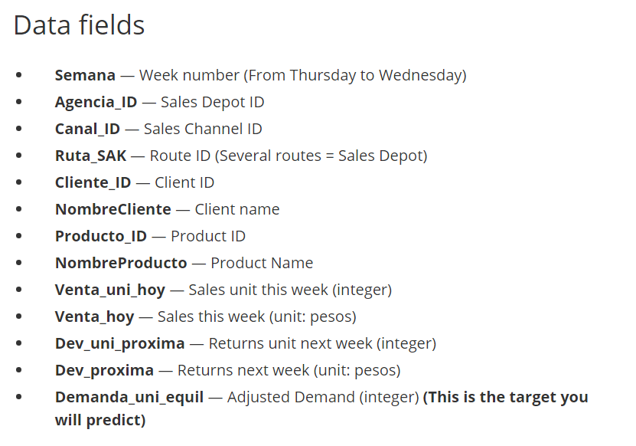
Dataset

Slide 6
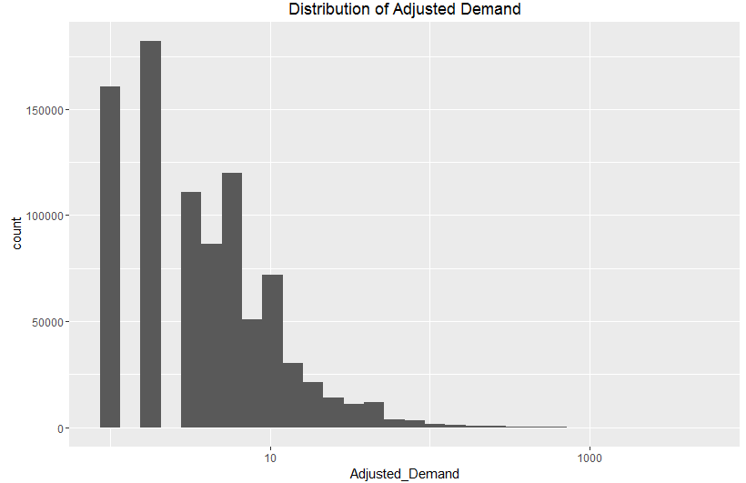
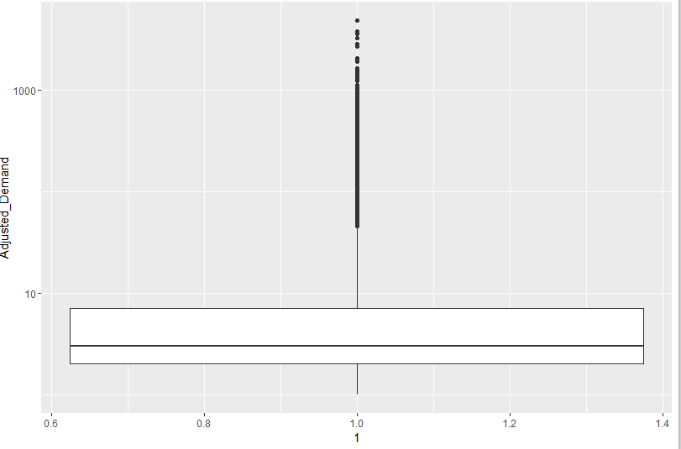
Data Exploration
Adjusted Demand
Observed some target values are much more common than others
Few big outliers, so zoomed with target values under 50

Slide 7
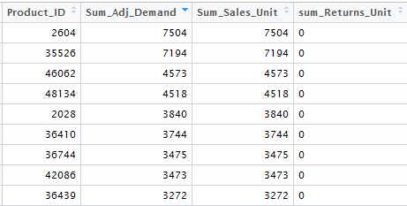
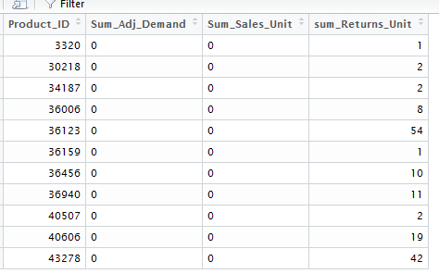
Data Exploration
Products
Some Products were in demand and had no returns
Some Products had 0 sales and only returns.

Slide 8
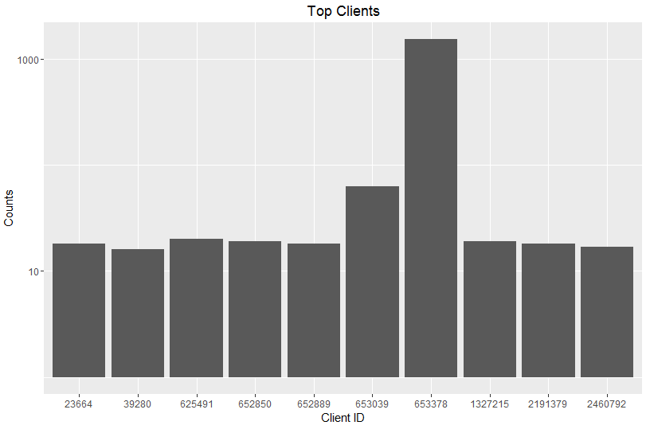
Data Exploration
Client ID
There was one big client “Puebla Remision” (653378).

Slide 9
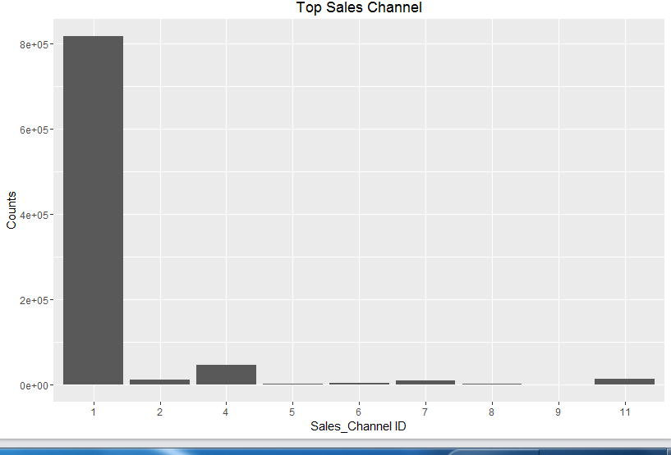
Data Exploration
Sales Channel ID
Sales Channel ID 1 is mostly used by Clients

Slide 10
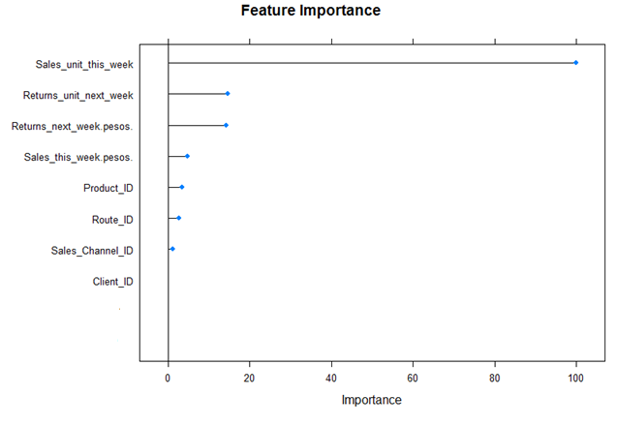
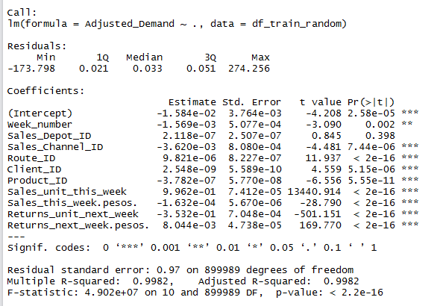
Feature Selection
Features with High Significance (***) were selected for fitting the model.

Slide 11
Random Forest
Random forests are an ensemble learning method for regression, that operate by constructing a multitude of decision trees at training time and outputting the mean prediction (regression) of the individual trees.
Each decision tree is constructed by using a random subset of the training data. After you have trained your forest, you can then pass each test row through it, in order to output a prediction.
Parameters used
ntree = 200
Mtry = 3
Nodesize = 42

Slide 12
Model Validation and Tuning hyper-parameters
Used K-Fold and Grid Search Cross Validation technique.
In k-fold cross-validation, the original sample is randomly partitioned into k equal sized subsample.
Of the k subsamples, a single subsample is retained as the validation data for testing the model, and the remaining k − 1 subsamples are used as training data.
The cross-validation process is then repeated k times (the folds), with each of the k subsamples used exactly once as the validation data. The k results from the folds can then be averaged to produce a single estimation.

Slide 13
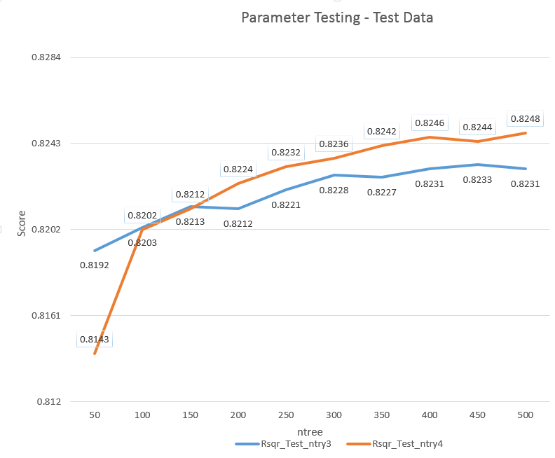
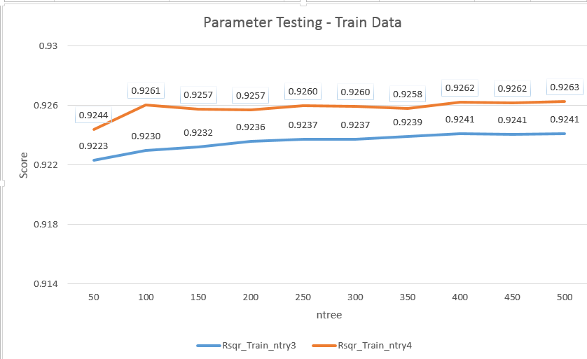
Model Validation and Tuning hyper-parameters

Slide 14
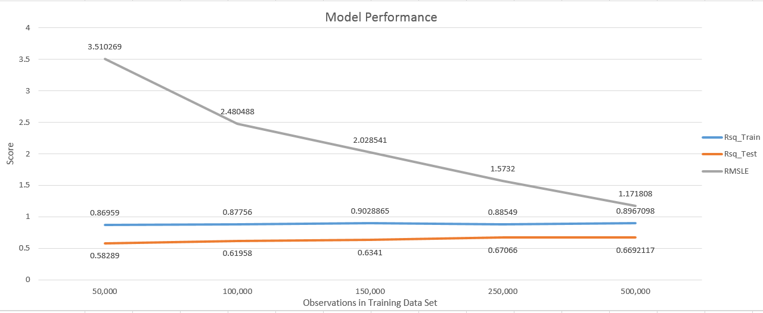
Model Performance
Train Data set had 70+ million observations out of which 900K observations were used.
Below is the Model performance with changing lengths of the Train Data set
As the number of observations in the Train data set increased, Rsquare also increased and RMSLE decreased.

Slide 15
Summary
The Model was tested with Validation Data set, unseen by the model
Rsquared = 0.83
RMSLE = 1.3955
Demands can vary anytime, additional observations will help understand demand variability and improve Model Performance.
Appropriate inventory of High Demand Products can be stored using the Model’s Prediction.
Marketing Team can use the Model to identify Products predicted to have low demand or no demand at all and build Promotion campaigns for them.

